Slide 1
Science Amphibians and Reptiles
Third Grade
Tennille Therrien
Next

Slide 2
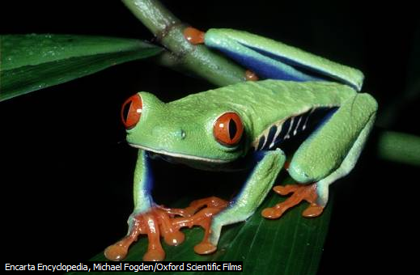
Contents
Reptiles
Amphibians
Quiz
Video
Previous
Next

Slide 3
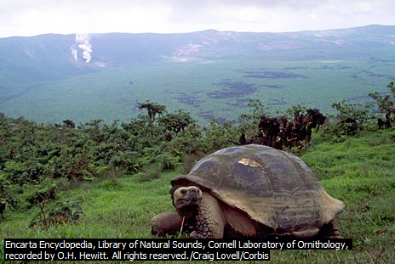
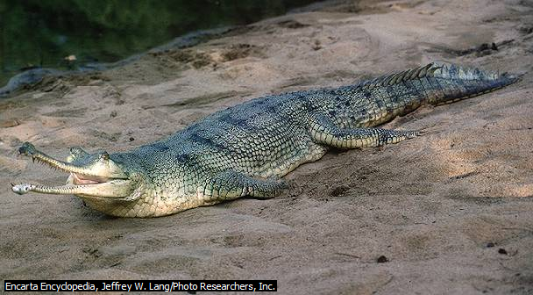
Reptiles
Reptile~ animal with tough, dry skin covered with horny scales. Some of the most common living reptiles are turtles, lizards, snakes, crocodiles, and alligators. Reptiles are vertebrates—animals that have a backbone.
Previous
Next

Slide 4
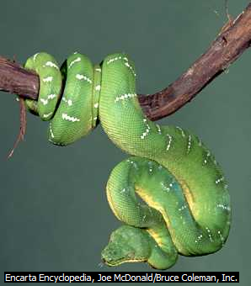
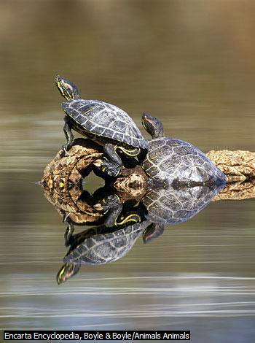
Reptiles
~Cold Blooded, also known as ectothermic
~ Unable to produce their own body heat
Previous
Next

Slide 5
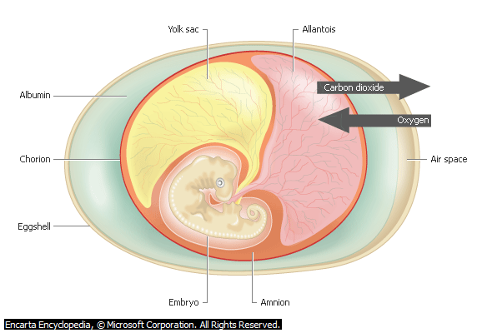
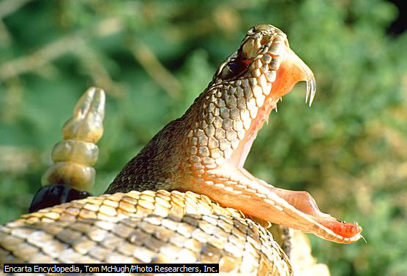
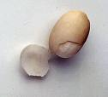
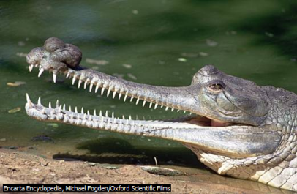
Reptiles
~Hatch from eggs that are laid on
land, covered by a protective shell.
~most reptiles, with the exception of turtles, have teeth.
Previous
Next

Slide 6
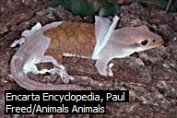
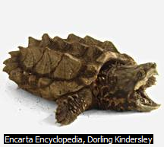
Reptiles
Have tough, horny scales that are unique in the animal world.
Previous
Next

Slide 7
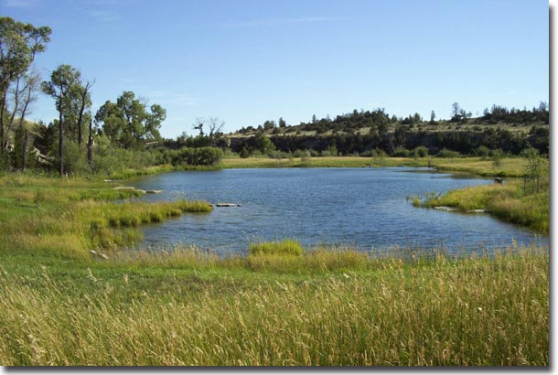
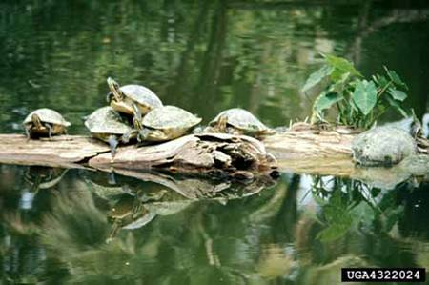
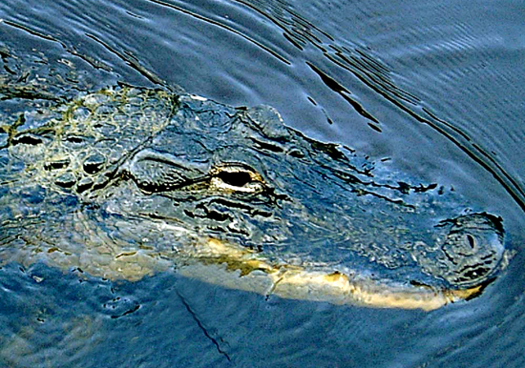
Reptiles
~Are found in a broad range of habitats, such as the
bottom of ponds and lakes.
Previous
Next

Slide 8
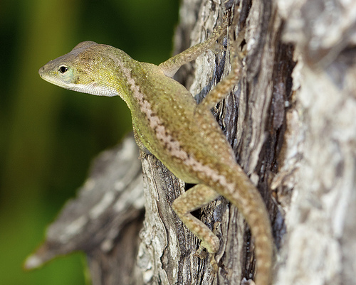
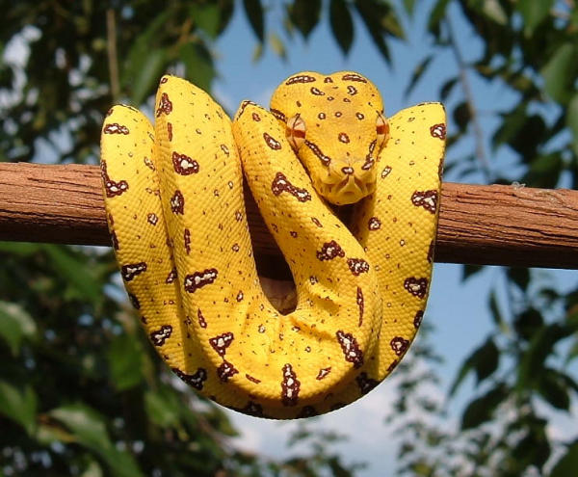
Reptiles
In trees
Previous
Next

Slide 9
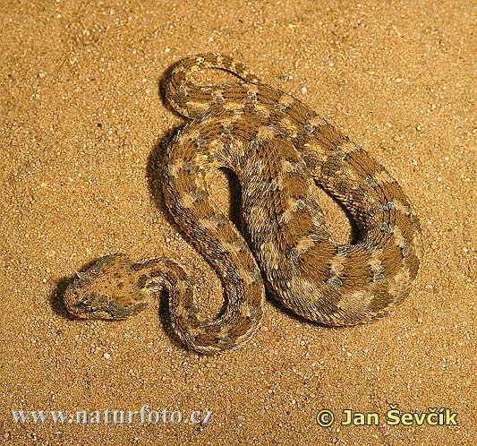
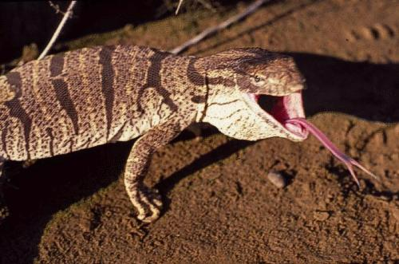
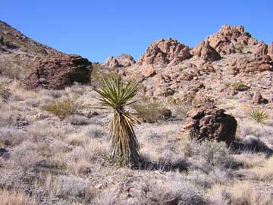
Reptiles
And are especially abundant and diverse in
tropics and the desert.
Previous
Next

Slide 10
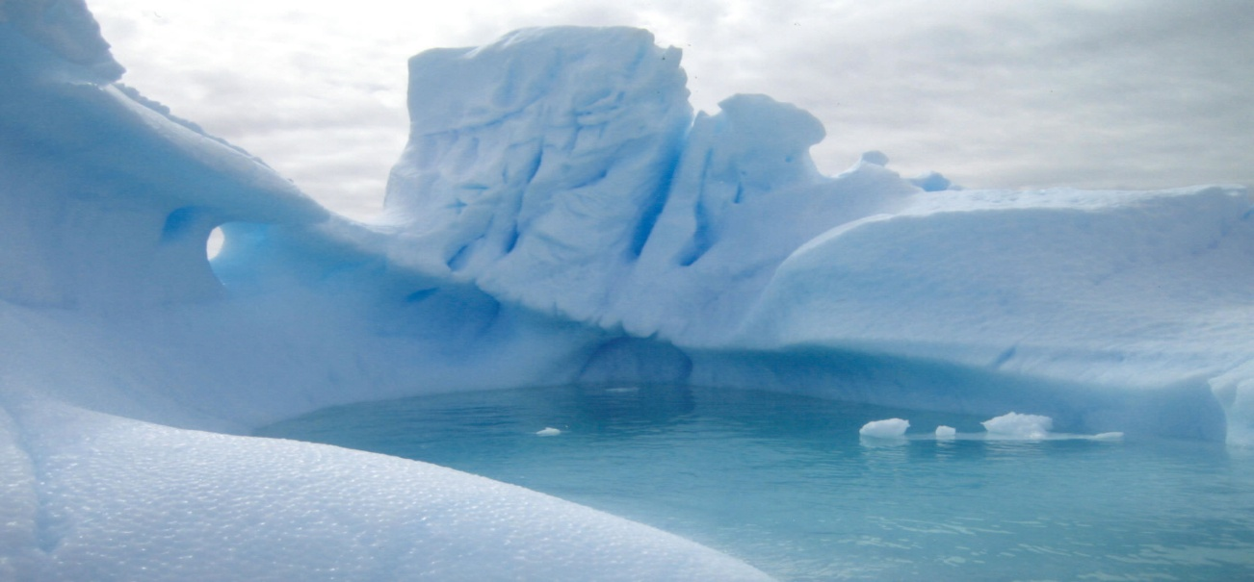
Reptiles
The single factor that limits their geographic
distribution is their inability to generate
their own body heat and for that reason, no reptiles
Are found in icy Antarctica or the polar oceans and
few live within the Arctic Circle.
previous
Next

Slide 11
Amphibians
Animals that have moist, hairless skin. Amphibians are cold-blooded like reptiles. The three main groups of amphibians are frogs and toads, salamanders, and caecilians.
Previous
Next

Slide 12
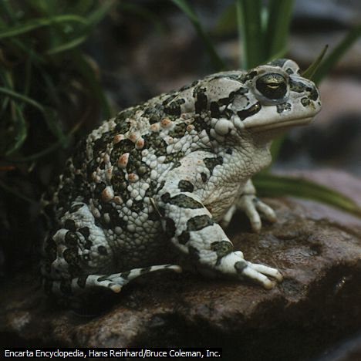
Amphibians
Frogs and toads are the most abundant of all amphibians, there are more than 4,000 species. Frogs have smooth skin and long limbs. Toads, in contrast, have warty skin and short limbs.
Previous
Next

Slide 13
Amphibians
Say you are thirsty. Can you put your hand in a glass of water and drink it through your skin? Of course you can’t! But some animals can absorb water this way. These animals are called amphibians.
Previous
Next

Slide 14
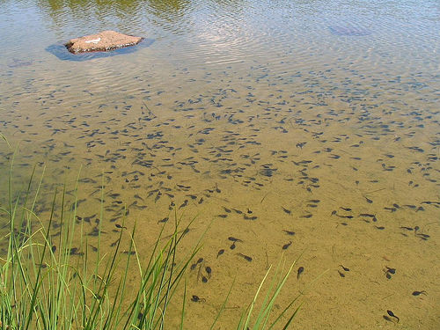
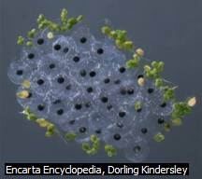
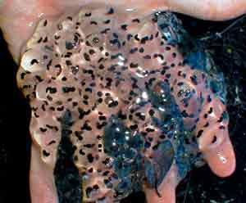
Amphibians
Most amphibians start out as larvae
Frog and toad larvae are sometimes called pollywogs or tadpoles.
Previous
Next

Slide 15
Frog Life Cycle
Previous
Next

Slide 16
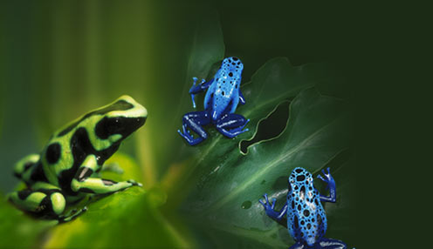
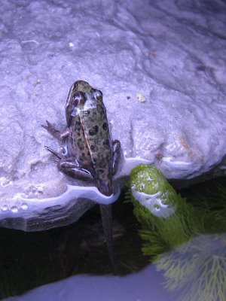
Amphibians
Spend the first part of their life in water and the second part on land.
Previous
Next

Slide 17
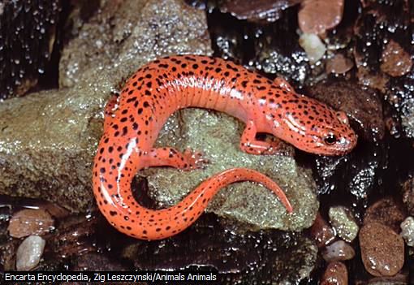
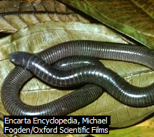
Amphibians
Some other types of amphibians include salamanders and caecilians
Previous
Next

Slide 18
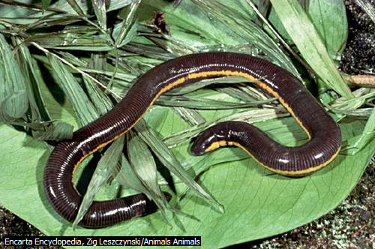
Amphibians
Caecilians~ The caecilian is a type of amphibian that has a wormlike body with no limbs. Caecilians are found only in the tropics.
Previous
Next

Slide 19
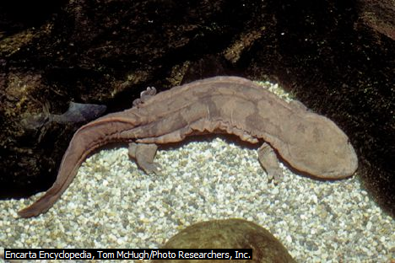
Amphibians
Salamander, shy, elusive animal that resembles a lizard but has smooth, delicate skin instead of scales.
Previous
Next

Slide 20
Quiz
Amphibians drink water through their skin.
True
False
contents
Next question

Slide 21
Good Job!
Previous

Slide 22
Try Again
Previous

Slide 23
Quiz
Frogs have warty skin and short limbs.
True
False
Previous
Next question

Slide 24
Good Job!
previous

Slide 25
Try Again
Previous

Slide 26
Quiz
Most reptiles start out as larvae.
True
False
previous
Contents

Slide 27
Good Job
Previous

Slide 28
Try Again
Previous

Slide 29
A really neat website
To learn more about this topic visit http://www.newtonsapple.tv
contents

Slide 30
Video
Took out video so my power point would download onto weebly.
Contents

Slide 31
Microsoft ® Encarta ® 2008. © 1993-2007 Microsoft
Corporation. All rights reserved.
Music by. Jack Johnson
contents

